Slide 1






FD LAB PRESENTATION
PREPARED BY:-P.Bala karthik 20761A0567
CSE-B

Slide 2

MY OBJECTIVE
TO DESIGN A WEBSITE FOR ORDER MILK PRODUCTS IN ONLINE SYSTEM

Slide 3
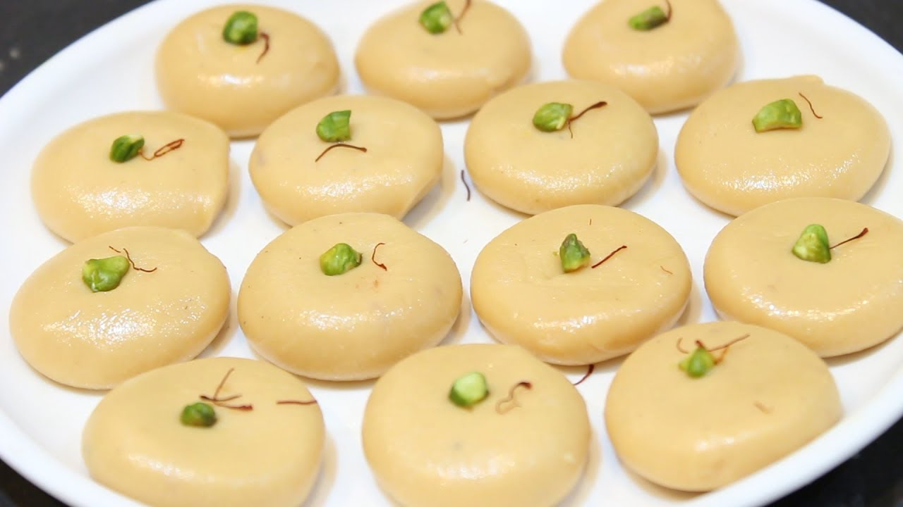
INTRODUCTION
LAUNCH ANY SWEET ORDER THROUGH ONLINE SYSTEM TO NEW CUSTOMERS.
IF YOU OFFER TO BUY A SWEET
THEN YOU HAVE TO GO TO SHOP AND ORDER YOUR ITEM.
MILK SWEETS ONLINE VIA YOUR WEBSITE TO REACH MORE CUSTOMERS MORE EASILY AND BOOST YOUR REVENUE.

Slide 4
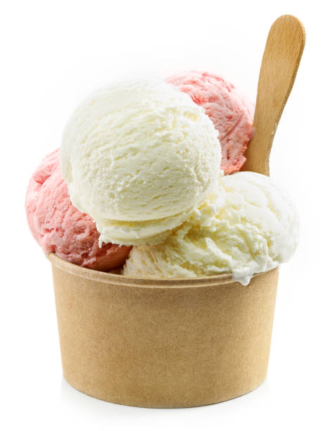
APPLICATION
MORE BURGER ORDERS WITH THE MOBILE APPLICATION
YOU CAN ABILITY TO GET YOUR PRODUCT THROUGH DELIVARY MODE
AND YOUCAN ALSO MAKE YOUR PAYMENT METHOD ON VIA ONLINE SYSTEM ONLY THROUGH YOUR DEBIT CARD,MASTER CARD,VISA ..
MAKE ORDERING THROUGH MOBILE DEVICES CAN MAKE YOU EASIER AND FASTER THAN EVER.
GIVE YOUR CUSTOMERS ACCESS TO THE NATIVE RESTARUTANT MOBILE APP WITH THE DAIRY PRODUCTS ONLINE ORDER FEATURE GROW YOUR CUSTOMERS BASE AND REVENUE

Slide 5
PRICES OF ITEMS ON OUR DAIRY PRODUCTS
PRODUCT TYPE | PRICE OF BURGER
ICE –CREAMS | RS 79 ON WARDS
SWEETS | RS 109 ON WARDS
MILK ITEMS | RS 109 ON WARDS

Slide 6
CONCEPTS COVERED IN HTML,CSS,AND JAVASCRIPT
LABELS
BUTTONS
TEXT FIELDS
TEXT AREA
EXTERNAL LINKING
BORDER PROPERTIES
EVENT HANDLER

Slide 7
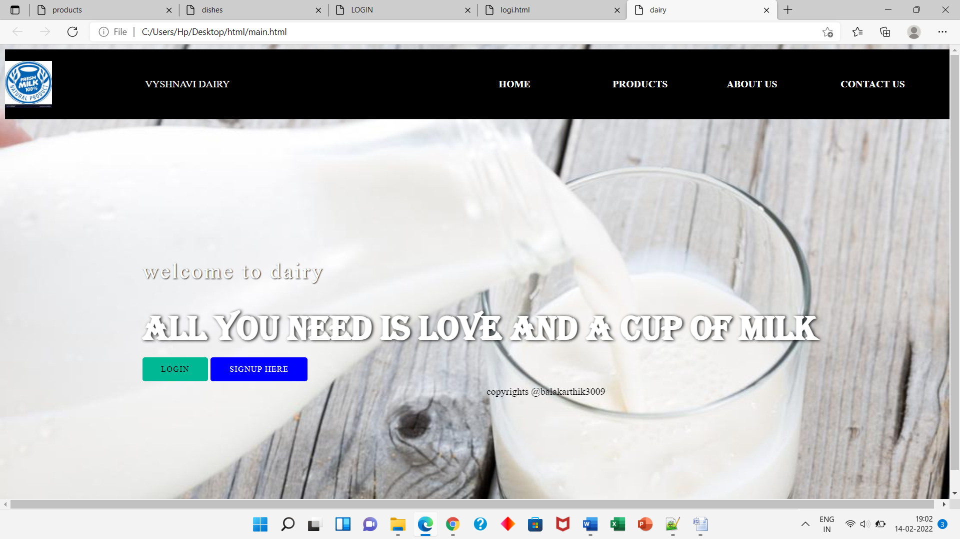
FINAL OUTPUT:----

Slide 8


